Slide 1



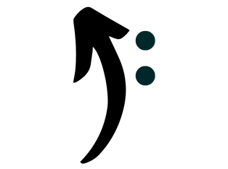
12:34
From The Top
Class: Welcome
Layout: activity_welcome
User Stories:
A free app for learning music theory.
CONTINUE

Slide 2
12:34
Class: SetName
Layout: activity_set_name
User Stories:
Please enter your name
Name
CONTINUE

Slide 3
12:34
Class: SetGoals
Layout: activity_set_goals
User Stories: 2
How many days per week do you want to test your knowledge?
CONTINUE

Slide 4
12:34
Class: SetGoals
Layout: activity_set_goals
User Stories: 2
How many days per week do you want to test your knowledge?
.
Not selected
---------------------------------------------
1
2
3
4
5
6
7
CONTINUE

Slide 5
12:34
Class: About
Layout: activity_about
User Stories: 1
[App info/walkthrough]
CONTINUE

Slide 6





12:34
Class: Home
Layout: activity_home
User Stories:
Home
Options button?
LEARN
QUIZ
MY STATS
SETTINGS

Slide 7




12:34
Class: Topics
Layout: activity_topics
User Stories:
Learn: Topics
RHYTHM
SCALES
INTERVALS

Slide 8
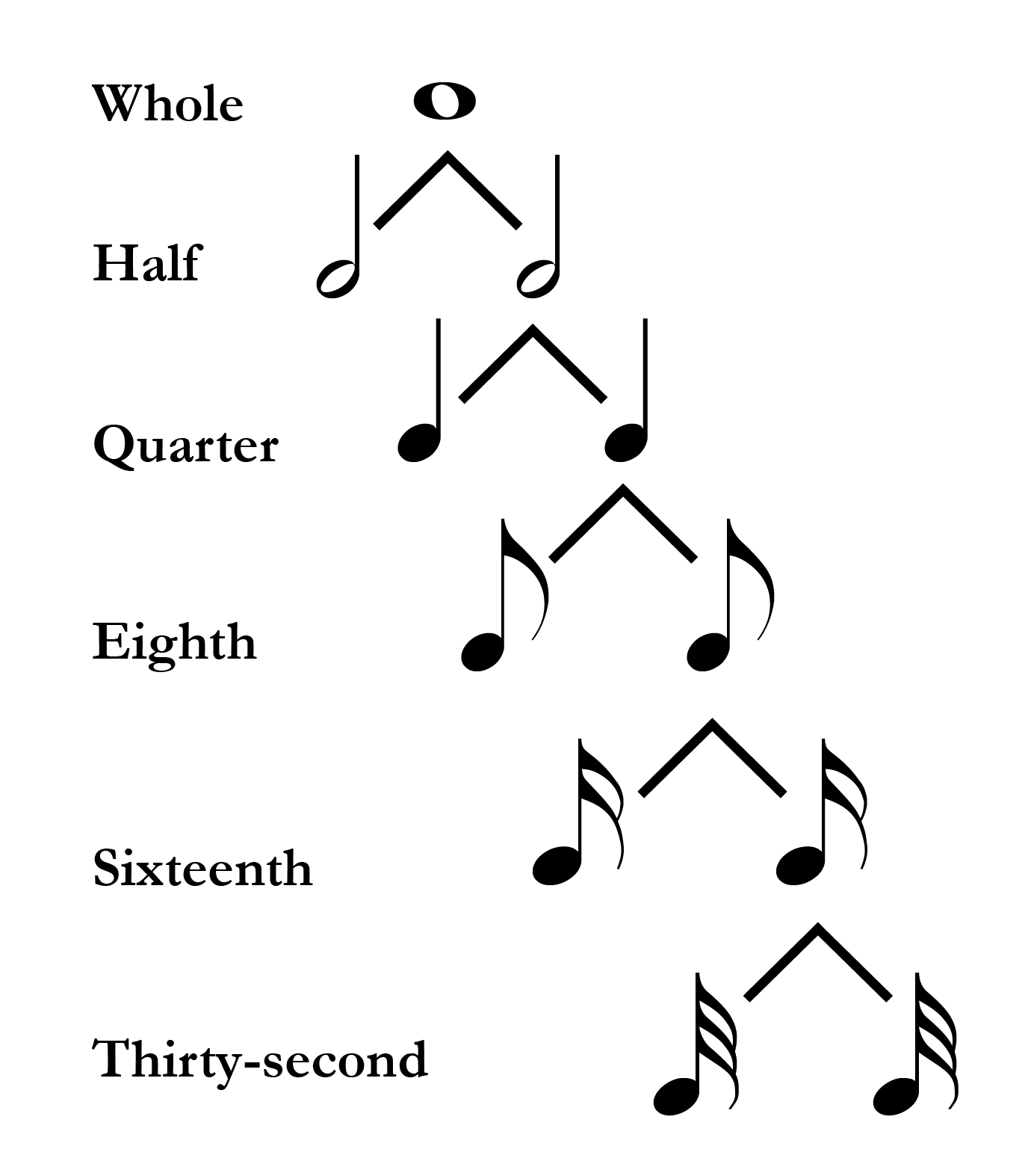
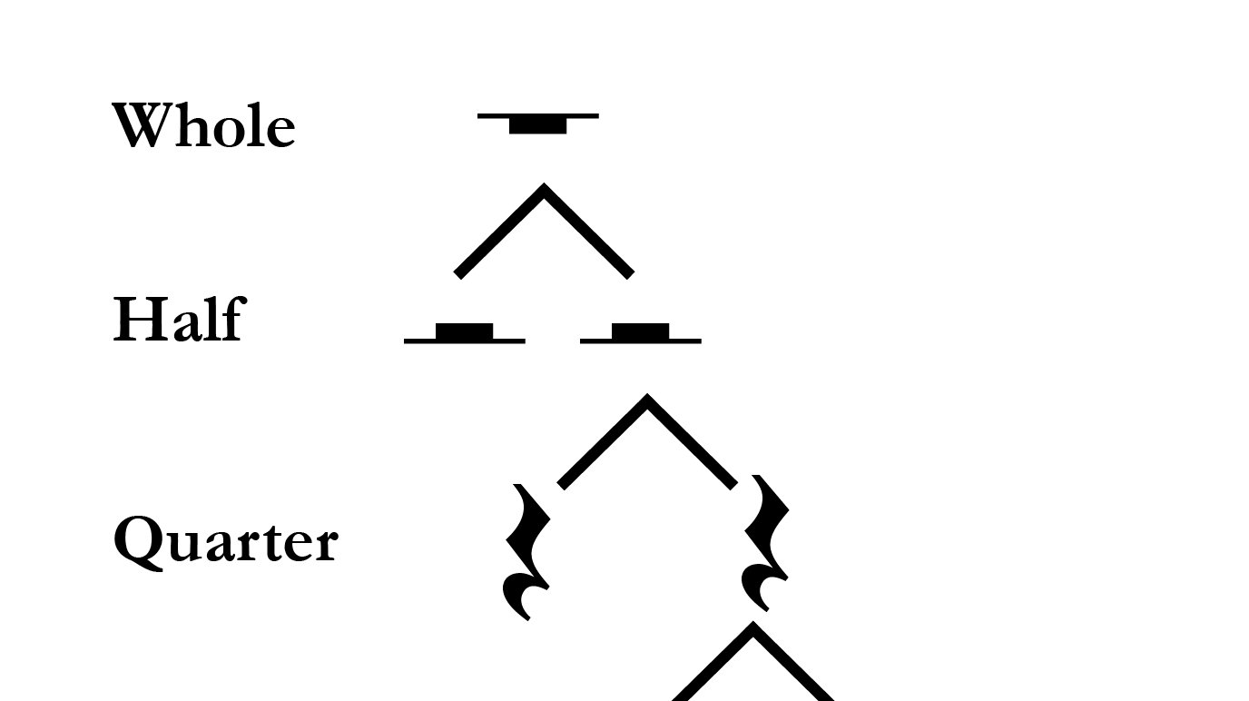

12:34
Class: LearnRhythm
Layout: activity_learn_rhythm
User Stories: 8
Rhythm
Rhythm refers to the combination of long and short durations in time. Durations are notated with either unfilled or filled noteheads. Unfilled noteheads can appear with or without a stem; filled noteheads always appear with a stem. Flags can be added to the stems of filled noteheads; each flag shortens the duration by half.
Rests
Rests represent silence in musical notation. For each durational symbol there exists a corresponding rest.
…
TEST MY KNOWLEDGE!

Slide 9



12:34
Class: LearnScales
Layout: activity_learn_scales
User Stories: 3, 8
Scales
A scale is a succession of pitches ascending or descending in steps. There are two types of steps: half steps and whole steps. A half step (H) consists of two adjacent pitches on the keyboard. A whole step (W) consists of two half steps. Usually, the pitches in a scale are each notated with different letter names, though this isn’t always possible or desirable.
The Chromatic Scale
The chromatic scale consists entirely of half steps, and uses every pitch on the keyboard within a single octave. Here is the chromatic scale that spans the pitches C4 through C5.
The major scale
A major scale, a sound with which you are undoubtedly familiar, consists of seven whole (W) and half (H) steps in the following succession: W-W-H-W-W-W-H. The first pitch of the scale, called the tonic, is the pitch upon which the rest of the scale is based. When the scale ascends, the tonic is repeated at the end an octave higher.
…
TEST MY KNOWLEDGE!

Slide 10

12:34
Class: LearnIntervals
Layout: activity_learn_intervale
User Stories: 3, 8
Intervals
An interval is the distance between two pitches, usually measured as a number of steps on a scale.
A dyad is a pair of pitches sounding together (in other words, a two-note chord). Since a dyad is defined by the interval between the two pitches, dyads are often simply called intervals.
Thus, the term interval regularly refers both to the distance between two pitches on a scale and to a dyad whose pitches are separated by that distance.
Chromatic intervals
The simplest way to measure intervals, particularly at the keyboard, is to count the number of half-steps, or semitones, between two pitches. To determine the chromatic interval between C4 and E4, for example, start at C4 and ascend the chromatic scale to E4, counting steps along the way: C#4, D4, D#4, E4. E4 is four semitones higher than C4. Chromatic intervals are notated with a lower-case i followed by an Arabic numeral for the number of semitones. C4–E4 is four semitones, or i4.
Diatonic intervals
More commonly for tonal music, we are interested in the number of steps on the diatonic (major or minor) scale. This is a bit tricky—not because it’s difficult, but because it’s …
…
TEST MY KNOWLEDGE!

Slide 11
12:34
Class: QuizActivity
Layout: activity_quiz
User Stories: 4
Score: 7
Question 10/10
Difficulty: Easy
Topic: Rhythm
00:30
How many beats does a minim last?
1
2
3
4
CONFIRM

Slide 12
12:34
Class: QuizActivity
Layout: activity_quiz
User Stories: 4, 5
Score: 7
Question 10/10
Difficulty: Easy
Topic: Rhythm
00:10
How many beats does a minim last?
1
2
3
4
Correct, well done!
FINISH

Slide 13

12:34
Class: QuizActivity
Layout: activity_quiz
User Stories: 4
Score: 3
Question 10/10
Difficulty: Easy
Topic: Scales
00:30
What scale is this?
D major
D melodic minor
B natural minor
F major
CONFIRM

Slide 14
12:34
Class: QuizActivity
Layout: activity_quiz
User Stories: 4, 5
Score: 3
Question 10/10
Difficulty: Easy
Topic: Scales
00:11
What scale is this?
D major
D melodic minor
B natural minor
F major
Incorrect
FINISH

Slide 15
12:34
Class: QuizResults
Layout: activity_quiz_results
User Stories: 7
Quiz complete!
SCORE
80%
TOPIC
DIFFICULTY
RHYTHM
EASY
Well done!
TRY MEDIUM
RETURN HOME

Slide 16
12:34
Class: QuizResults
Layout: activity_quiz_results
User Stories: 7
Quiz complete!
SCORE
30%
TOPIC
DIFFICULTY
SCALES
EASY
You can do better!
REVISE
TRY AGAIN
RETURN HOME

Slide 17
12:34
Class: QuizSelect
Layout: activity_quiz_select
User Stories:
Quiz: Topics
RHYTHM
SCALES
INTERVALS

Slide 18
12:34
Class: QuizRhythm
Layout: activity_quiz_rhythm
User Stories: 6, 11
Quiz: Rhythm
EASY
Number of Attempts:
2
High Score:
80%
MEDIUM
Number of Attempts:
1
High Score:
60%
DIFFICULT
Number of Attempts:
0
High Score:
N/A

Slide 19

12:34
Class: Stats
Layout: activity_stats
User Stories: 11
My Stats
RHYTHM
Need to change the dark blue because they look like buttons
Easy
Attempts: 2
Best: 80%
Course:
Medium
Attempts: 1
Best: 60%
Hard
Attempts: 0
Best: N/A
SCALES
Easy
Attempts: 1
Best: 30%
Medium
Attempts: 0
Best: N/A
Hard
Attempts: 0
Best: N/A
Course Completed: No
INTERVALS
Easy
Attempts: 0
Best: N/A
Course:
Medium
Attempts: 0
Best: N/A
Hard
Attempts: 0
Best: N/A

Slide 20
12:34
Class: Settings
Layout: activity_settings
User Stories:
Settings

Slide 21
12:34
Class:
Layout:
User Stories:

